Slide 1
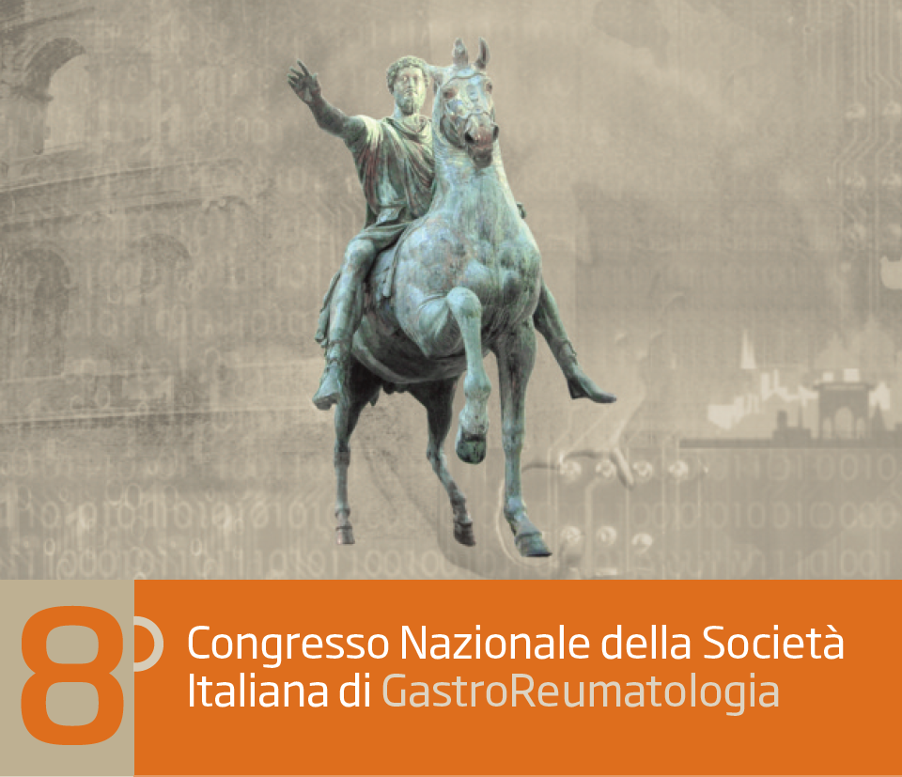
PREVENZIONE DELLA RECIDIVA
POST-CHIRURGICA DELLA MALATTIA DI CROHN
Dalla Mesalazina agli Immunomodulatori: Indicazioni ed Efficacia
Annalisa Aratari
UOS MICI
Ospedale San Filippo Neri, Roma

Slide 2
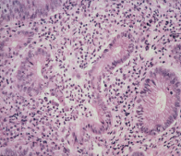
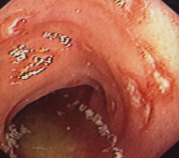

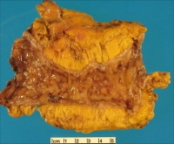
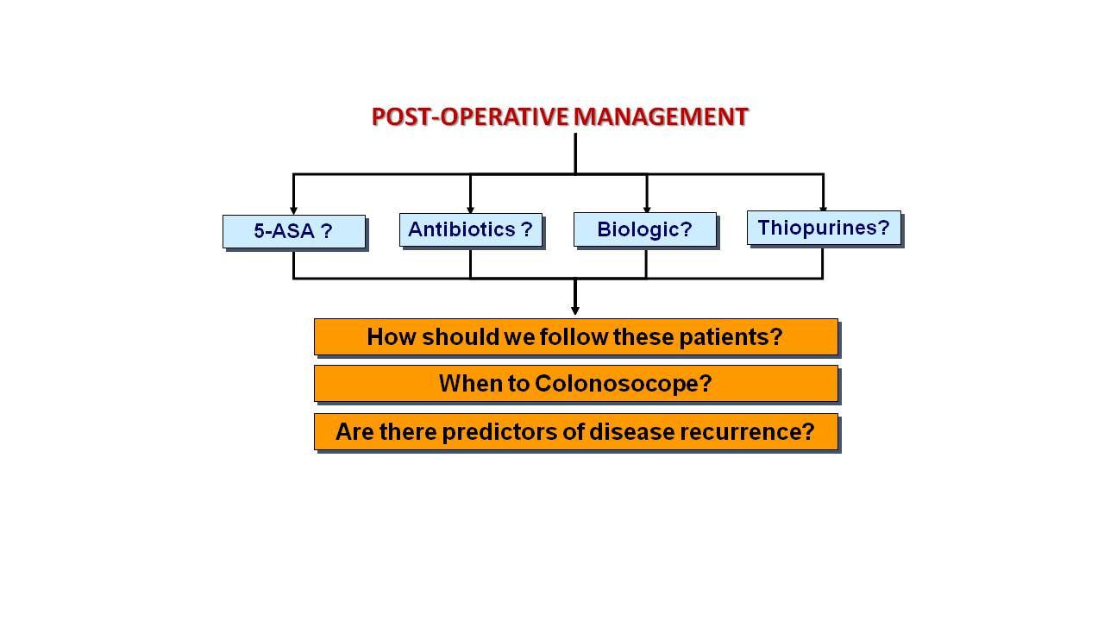
Symptoms
Complications
Natural history
of
Crohn’s disease
Lesions
Surgery
50% pts
at 10 years from diagnosis
Post-operative recurrence
D’Haens G, Geboes K, Peeters M, et al. Gastroenterology 1998;114:262-267. Olaison G, S medh K, Sjodahl R. Gut 1992;33:331-335. Rutgeerts P, Geboes K, Vantrappen G, et al Gastroenterology 1990;99:956-983. Sachar DB. Med Clin North Am 1990;74:183-188.

Slide 3

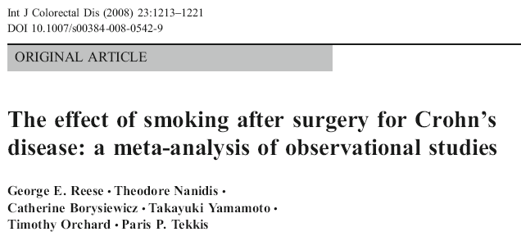

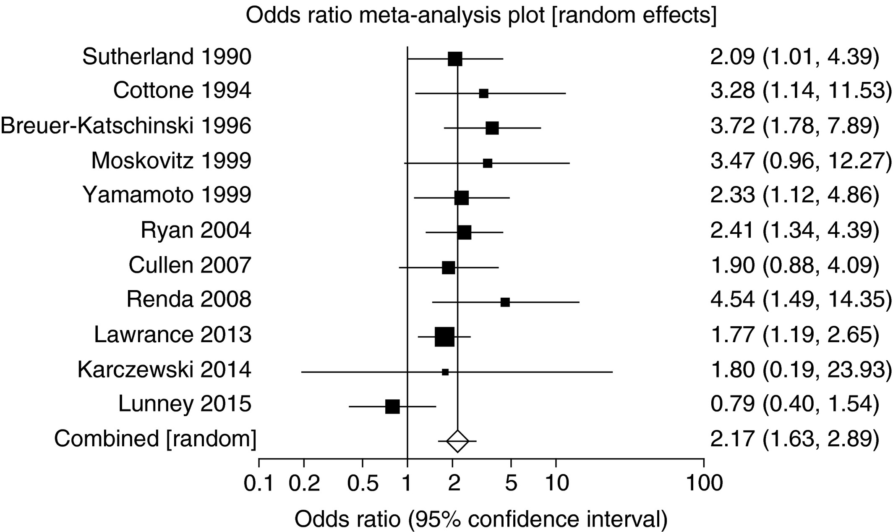
FIRST THERAPY : stop smoking !
CLINICAL RECURRENCE
SURGICAL RECURRENCE
58.3%vs39%; OR 2.07; 95%CI 1.25-3.44
65.7%vs42.4%; OR 2.01; 95%CI 1.06-3.80
42.4%vs34.9%; OR 1.54; 95%CI 0.78-3.02

Slide 4
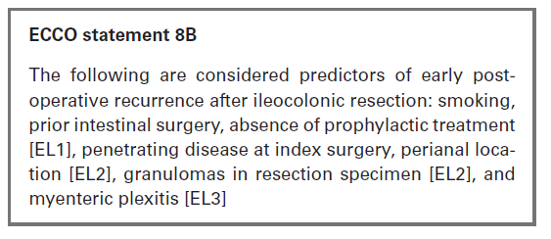
Methodological Consideration: risk factors and outcome
Intestinal resection
Risk factors for recurrence (low vs high risk)
Primary Prophylaxis according to risk factors
End point
1 year
5 years
1. Endoscopic recurrence
60-80%
100%
Endoscopic evaluation
6-12 months after surgery
Symptoms occurrence
Refractoriness /Complications /
Re-operation

Slide 5
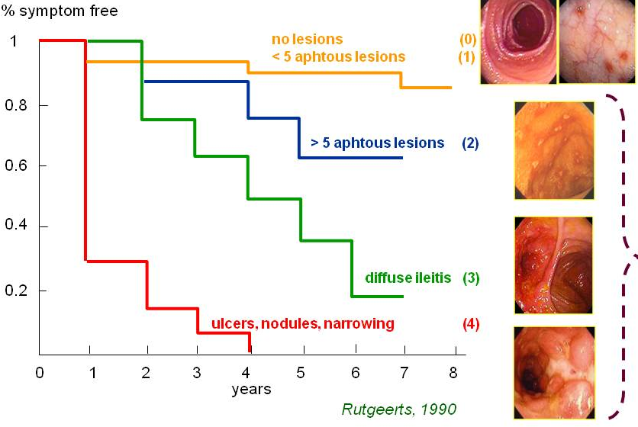
Methodological Consideration: risk factors and outcome
Intestinal resection
Risk factors for recurrence (low vs high risk)
Primary Prophylaxis according to risk factors
End point
1 year
5 years
1. Endoscopic recurrence
60-80%
100%
Endoscopic evaluation
6-12 months after surgery
Stratifying risk according to Rutgeerts score
Symptoms occurrence
Refractoriness /Complications /
Re-operation

Slide 6
Methodological Consideration: risk factors and outcome
Intestinal resection
Risk factors for recurrence (low vs high risk)
Primary Prophylaxis according to risk factors
End point
1 year
5 years
1. Endoscopic recurrence
60-80%
100%
Endoscopic evaluation
6-12 months after surgery
Stratifying risk according to Rutgeerts score
Treatment according to endoscopic recurrence
End points
1 year
5 years
2. Clinical recurrence
3. Surgical recurrence
Symptoms occurrence
10-30%
5%
22-59%
16-43%
definition of recurrence/end point
sample size
duration follow-up (trial and observational studies)
Refractoriness /Complications /
Re-operation

Slide 7
Methodological Consideration: sample size
SEVERE ENDOSCOPIC RECURRENCE
CLINICAL RECURRENCE
The pooled estimate 50.2% (95% CI, 28–73)
Heterogeneity (p= 0.0003)
The pooled estimate 23.7% (95% CI, 13–35)
Heterogeneity (p < 0.0001)

Slide 8
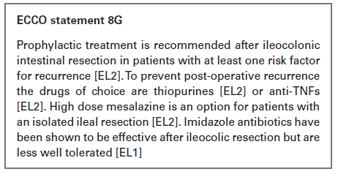

Mesalazine
Author, years | n. studies | Endpoint | Efficacy | NNT
Cammà, 1997 | 4 | Clinical recurrence | RD -13% (95%IC 21.8%,-4.5%) | 8
Cottone, 2000 | 5 | Clinical recurrence | RD -10% (95%IC 16.9%,-3.2%) | 10
Cammà, 2002 | 8 | Clinical recurrence Endoscopic recurrence Severe endoscopic recurrence | RD -15% (95%IC 23%,-8%) RD -18% (95%IC 24%,-10%) RD -22% (95%IC 35%,-10%) | 7 6 5
Doherty, 2009 | 5 | Clinical recurrence Endoscopic recurrence Severe endoscopic recurrence | RR 0.76 (95%IC 0.62-0.94) RR 0.93 (95%IC 0.76-1.13) ns RR 0.50 (95%IC 0.29-0.84) | 12 - 8
Gordon, 2011 | 5 | Clinical recurrence | OR 0.69 (95%IC 0.5-0.95) | 18
Ford, 2011 | 6 | Clinical recurrence | RR 0.80 (95%IC 0.70-0.92) | 10
Cohcrane, 2019 | 5 | Clinical recurrence Endoscopic recurrence | RR 0.83 (95%IC 0.72-0.96) RR 0.83 (95%IC 0.56-1.24) ns | 17 -
Notes:
Bisogna trattare 10 pazienti per 3 anni per prevenire una recidiva endoscopica

Slide 9
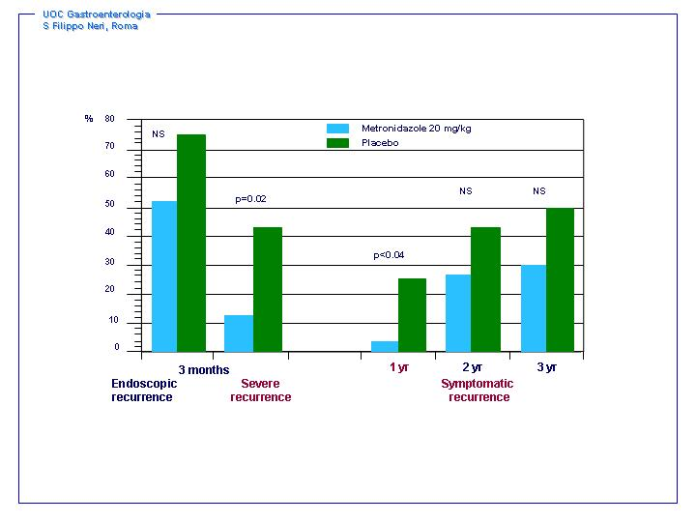
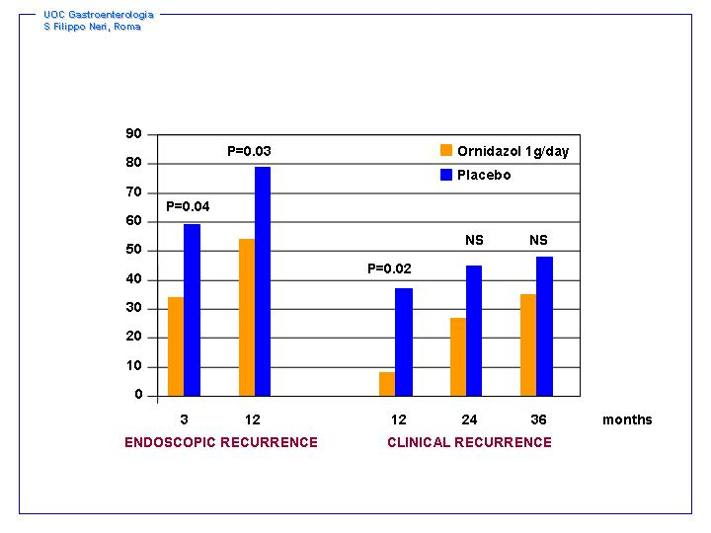
Antibiotics
METRONIDAZOLE
ORNIDAZOL
Rutgeerts et al Gastroenterology 1995
P. Rutgeerts et al, Gastroenterology. 2005
Reduced the risk of clinical recurrence (RR 0.23; 95% CI 0.09-0.57, NNT = 4)
Reduced the risk of endoscopic recurrence (RR 0.44; 95% CI 0.26-0.74, NNT = 4)
Doherty et al. Aliment Pharmacol Ther. 2010
Side Effects

Slide 10
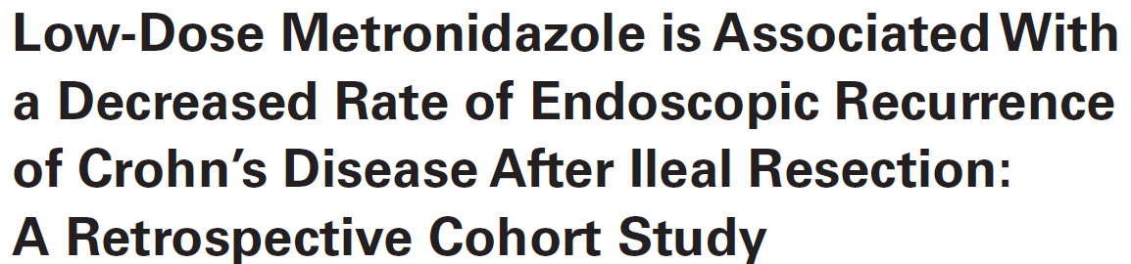
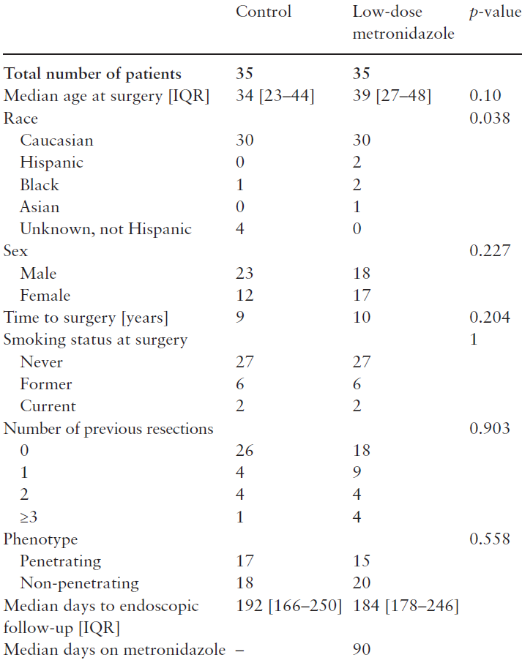
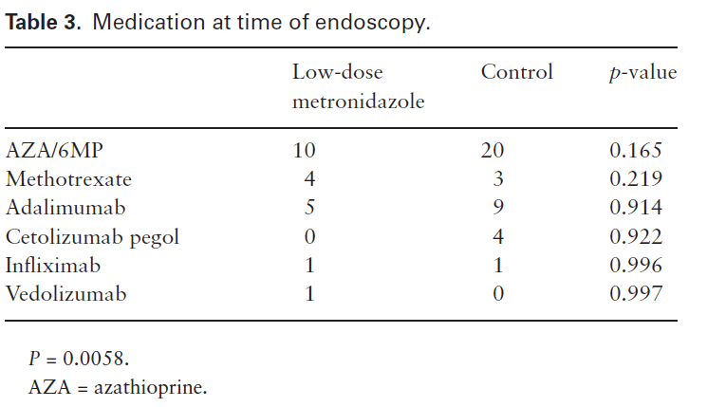
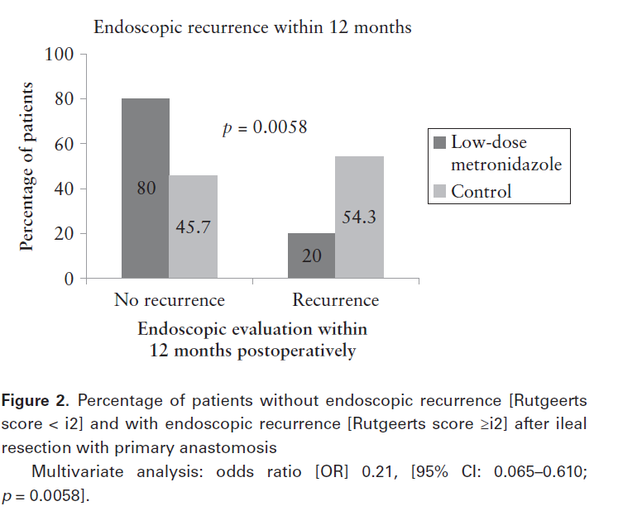


Antibiotics
250 mg 3 times daily for 3 months
Dropouts 3

Slide 11
Tiopurines

Slide 12
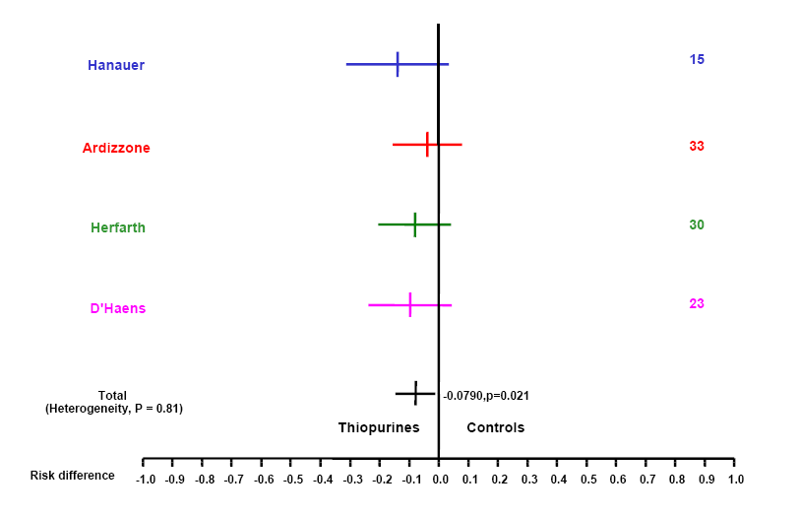
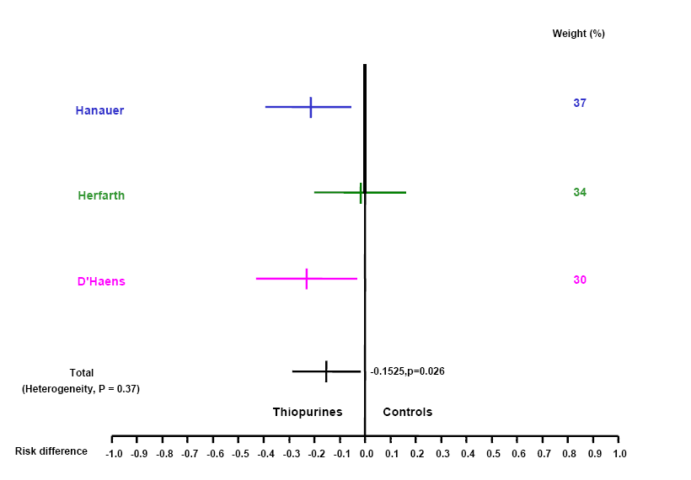
Tiopurines
CLINICAL RECURRENCE
SEVERE ENDOSCOPIC RECURRENCE
AZA (50 mg) vs ASA vs placebo
(131 pts) 69% completed the 2 years f-up
Clinical > Endoscopic recurrence
conservative surgery
AZA vs ASA, (letter)
37/79 (46%) completed 1 year f-up
METRO + AZA vs
METRO + Placebo
60/81 (74%) completed 1 years f-up
NNT 13
NNT 7
433 pts
293 pts
Peyrin-Biroulet L et al. AJG 2009; 104:2089-96
Notes:
PRESUPPOSTO ASA= PLACEBO
Hanauer AZA SOTTODOSATA (50 MG) VS ASA vs placebo (131 pts) a 2 anni
Herfarth PUBBLICATO COME LETTERA NEL 2006, AZA vs ASA, CON SAMPLE SIDE INSUFFICIENTE, SOLO 37/79 (la metà) PTS ARRIVANO A 1 ANNO
D’Haens CONFRONTO AZA+ METRO VS PLACEBO + METRO, 20/81 (solo ¼ dei pz) non completano lo studio a 1 anno, NUMEROSITà INSUFFICIENTE PER VALUTARE LA RECIDIVA CLINICA A 1 ANNO
Ardizzone chirurgia non resettiva

Slide 13

Tiopurines
D’Haens 2008
Hanuer 2004
Mowat 2016
D’Haens 2008
Mowat 2016
D’Haens 2008
Mowat 2016
Ardizzone 2004
Herfarth 2006
Savarino 2013
Hanauer 2004
Savarino 2013
28
Ardizzone 2004
Herfarth 2006
Savarino 2013
Hanauer 2004
“Moderate evidence thiopurines may be superior to placebo - No clear difference in clinical relapses compared with 5-ASA….however this is based on low certainty evidence…very low certainty evidence in more serious adverse events compared to 5‐ASA“
Notes:
MOWAT : 240 PTS, 6-MP PER 3 ANNI vs placebo, la riduzione della recidiva clinica però è presente solo nei fumatori. NNT 3 per fumatori, 31 per non fumatori
Sample side fumatori sono a maggior rischio e vedo la significatività
Discorso sul CDAI

Slide 14
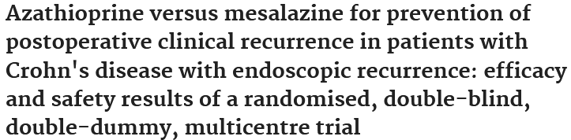
Tiopurines
p=0.002
ns
p=0.002
p=0.03
pts
9/41
4/37
0/41
4/37
9/41
0/37
19/30
11/32
at 1 year
Reinish W, Gut 2010

Slide 15
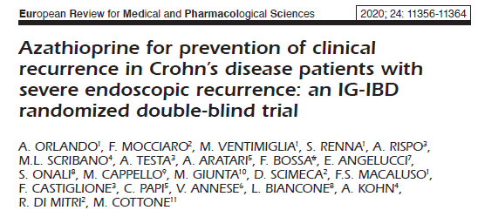
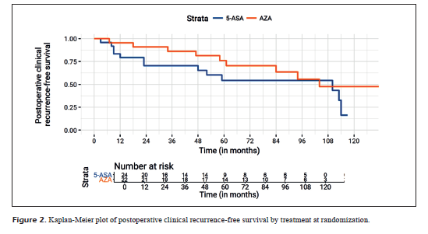
Tiopurines

Slide 16
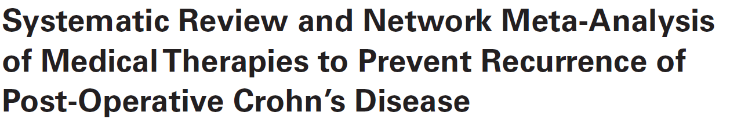
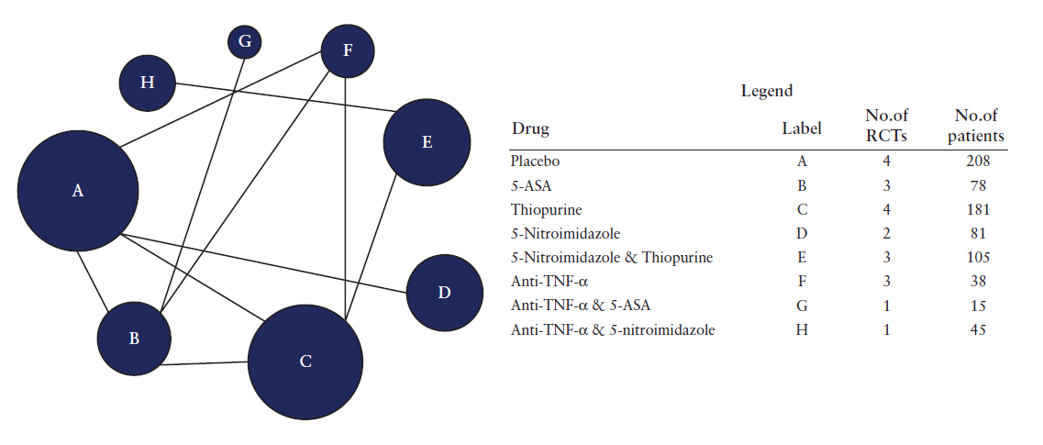
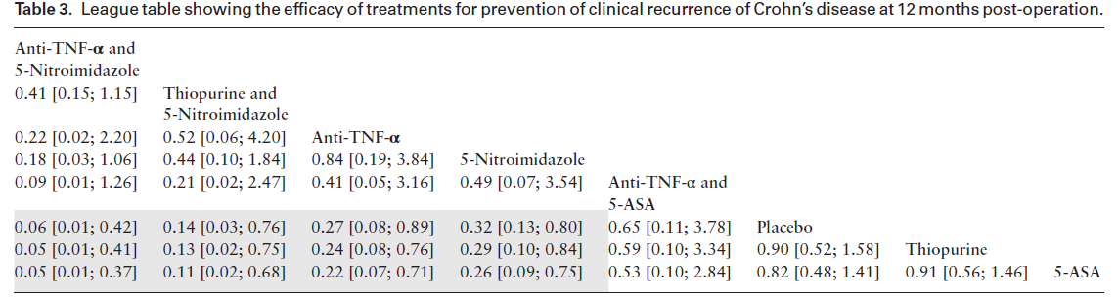
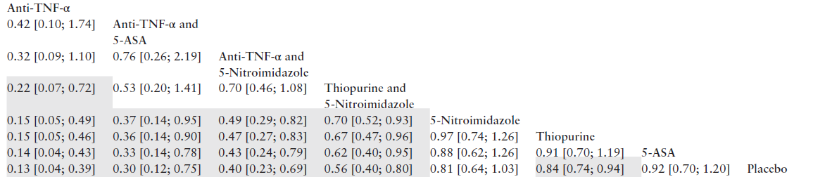
Network Metanalysis
CLINICAL RECURRENCE
ENDOSCOPIC RECURRENCE

Slide 17
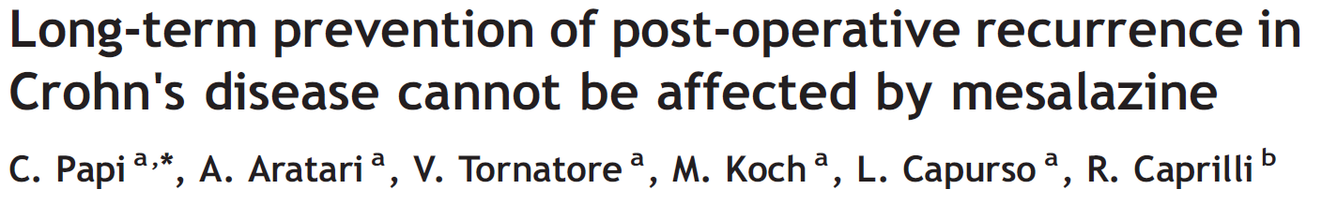
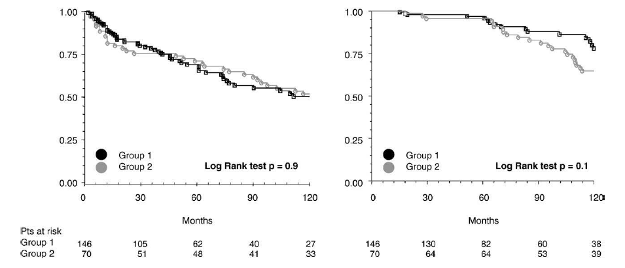
LONG TERM IMPACT- Mesalamine
216 pts
Mesalamine 146 (67%) pts
Clinical recurrence 86 /216 (40%) pts
Surgical recurrence 38/216 (18%) pts
CLINICAL RECURRENCE
SURGICAL RECURRENCE
- Group 1: continuative postoperative mesalazine
- Group 2: patients who had not received any postoperative treatment

Slide 18
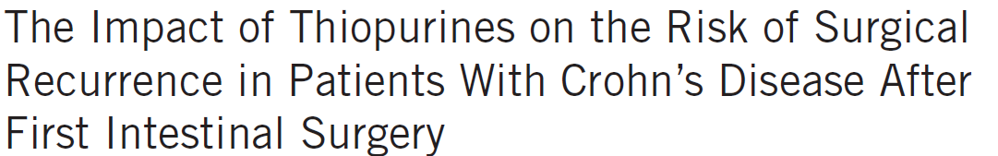
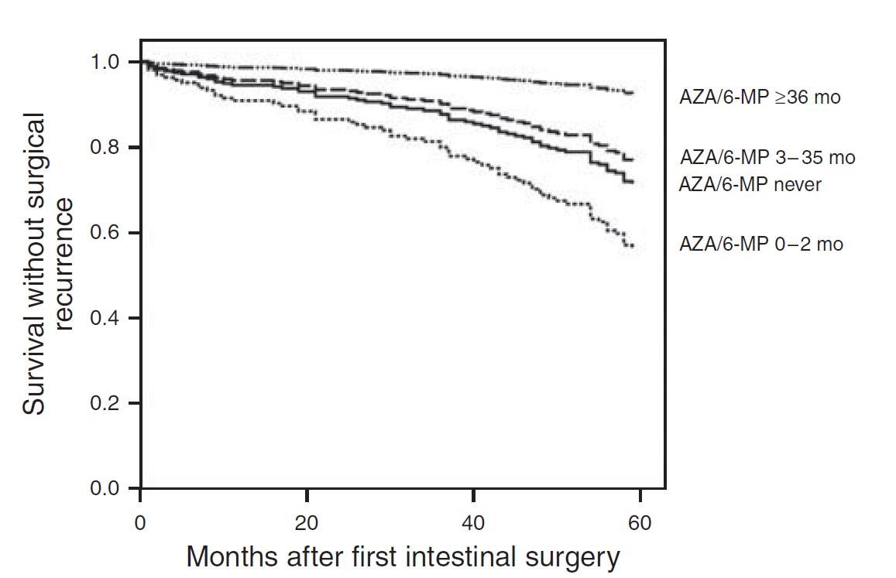
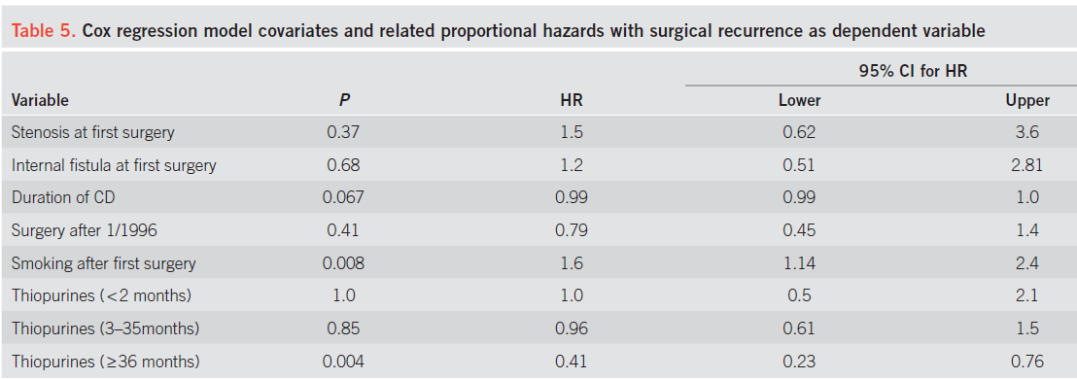
LONG TERM IMPACT- Tiopurines
326 pts
Thiopurine 161 (49%) pts
Surgical recurrence 151/326 (46%) pts
Papay P et al. Am J Gastroenterol 2009

Slide 19
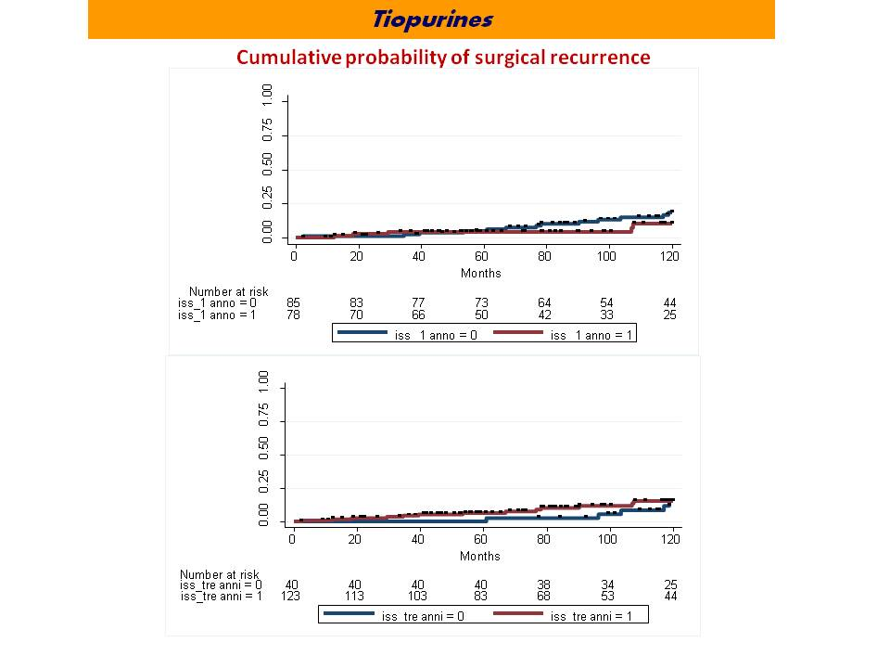
LONG TERM IMPACT- Mesalamine
Cumulative probability without ISS prescription after first surgery
Postoperative treatment with ISS
in ileo-cecal Crohn’s disease:
the long term impact on surgical recurrence
0
0
.
1
5
7
.
0
A. Aratari, ML. Scribano, D. Pugliese, F. De Biasio, S. Festa, V. Baccolini, C. Papi
Unpublished data
0
5
.
0
5
2
Population n=657 | 1980-1998 n=198 | 1999-2009 n=218 | 2010-2020 n=241
.
0
Logrank <0.0001
0
Logrank <0.0001
0
.
0
0
40
analysis time
80
120
coorte = 1980-1998
coorte = 1999-2009
coorte = 2010-2020
0
Cumulative probability without surgical recurrence
Cumulative probability of surgical recurrence in early ISS
(within 1 or 3 yrs)
0
.
1
5
7
.
0
0
5
.
0
5
2
.
0
0
0
.
0
0
40
analysis time
80
120
coorte = 1980-1998
coorte = 1999-2009
coorte = 2010-2020

Slide 20
CONCLUSIONS
Stop smoking is mandatory in all patients regardless of risk factors
of recurrence
Prophylactic treatment should be tailored according to risk factors
and “re-tailored” according to endoscopic findings at 6-12 months
after surgery
Mesalazine and thiopurines have a marginal effect for preventing
clinical and endoscopic recurrence in the short-term
Imidazole antibiotics have been shown to be effective after ileo-
colonic resection, but are poorly tolerated
The impact of these treatments on long-term post-operative course
(surgical recurrence) needs further evaluations
Grazie per l’attenzione

Slide 22
CONCLUSIONS
Stop smoking is mandatory in all patients regardless of risk factors of recurrence
Prophylactic treatment should be tailored according to risk factors and
“re-tailored” according to endoscopic findings at 6-12 moths after surgery
Mesalazine and thiopurines have a marginal effect for preventing clinical and
endoscopical recurrence in the short-term
Imidazole antibiotics have been shown to be effective after ileo-colonic resection,
but are poorly tolerated
The impact of these treatments on long-term post-operative course (surgical recurrence)
needs further evaluations
Grazie per l’attenzione

Slide 23
Intestinal resection
Risk factors for recurrence (low vs high risk)
Endoscopic evaluation
6-12 months after surgery
Stratifying risk according to Rutgeerts score
Risk f
ENDPOINTS:
ENDOSCOPIC RECURRENCE
CLINICAL RECURRENCE
SURGICAL RECURRENCE

Slide 24
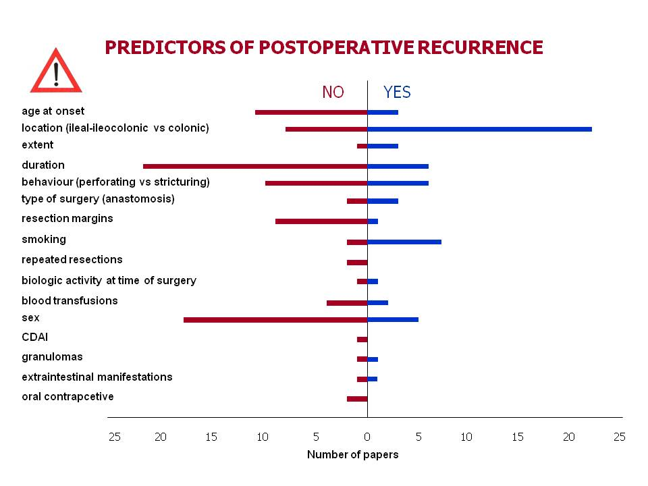
It is possible to stratify the patients’ risk?
Intestinal resection
Risk factors for recurrence (low vs high risk)
Retrospective studies
Different study designs
Different definition of recurrence (endoscopic/clinical/surgical)
Different follow-up

Slide 25
Months from surgery to first prescription within 10 years FU
Total Population N=657 | 1980-1998 N=198 | 1999-2009 N=218 | 2010-2020 N=241 | p-value
Immunosuppressants (mean, SD) | 23.6 (28.1) | 63.9 (30.1) | 25.6 (27.3) | 13.1 (21.0) | Logrank test: <0.0001
Immunosuppressants (median, IQR) | 12.2 (1.7-35.5) | 70.0 (36.5-82.2) | 15.2 (3.7-39.6) | 4.6 (1.0-15.2)

Slide 26
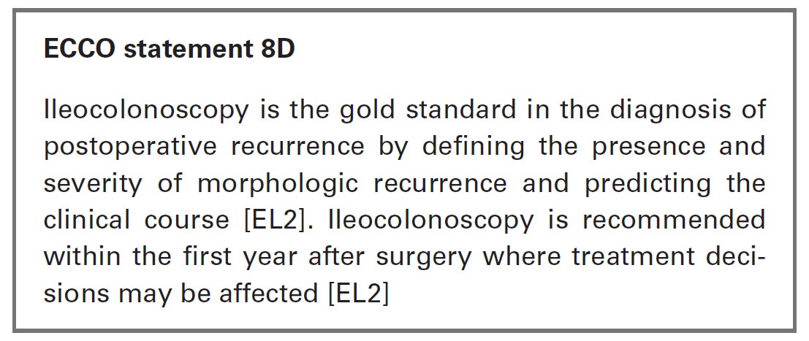
ENDOSCOPY
Endoscopy is the gold standard
for the diagnosis
of morphological recurrence
Endoscopic evaluation
6-12 months after surgery
Stratifying risk according to Rutgeerts score
Endoscopic features
are a prognostic factor
of clinical relapse

Slide 28
Tiopurines
Gastroenterology 2004
Assuming
35% clinical recurrence in placebo
10% reduction risk with mesalamine
656 pts treated with mesalamine
35% clinical recurrence in placebo
20% reduction risk with AZA
154 pts treated with AZA
35% clinical recurrence in placebo
15% reduction risk with AZA
240 pts treated with AZA
25% clinical recurrence in mesalamine
10% reduction risk with AZA
500 pts treated with AZA
ADEGUATELY
POWERED
TRIAL
TO SHOW
STATISTICAL
SIGNIFICANCE

Slide 30
Tiopurines
Cumulative probability
of surgical recurrence
No difference of cumulative probability of surgical recurrence were observed between
patients receving or not
early post-operative immunosuppressant therapy
(within 1 or 3 yrs from first surgery)
Postoperative treatment with biological and immunosuppressant in ileo-cecal Crohn’s disease: the long term impact on surgical recurrence
A. Aratari, ML. Scribano¹, V. Baccolini², D. Pugliese³, F. De Biasio, S. Verna¹, S. Festa, A. Armuzzi, C. Papi. Unpublished data

Slide 31
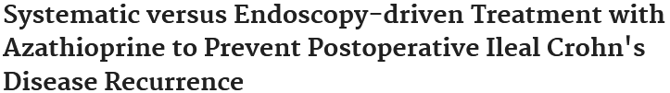
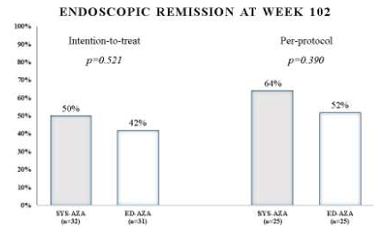

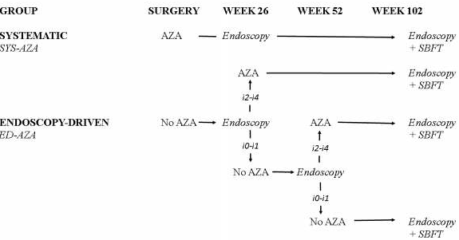
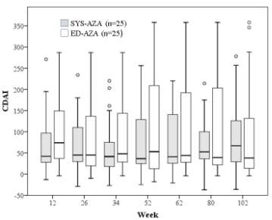
Tiopurines
32 pts
32 pts
31 pts
25pts
25pts
31 pts
Prematurely stopped due to slow recruiment (2005-2011)
Pts with at least 1 risk factors for recurrence
21/63 (33%) pts withdrew prematurely: 6 pts due to AZA adverse events
No difference with an increasing numbers of risk factors

Slide 32
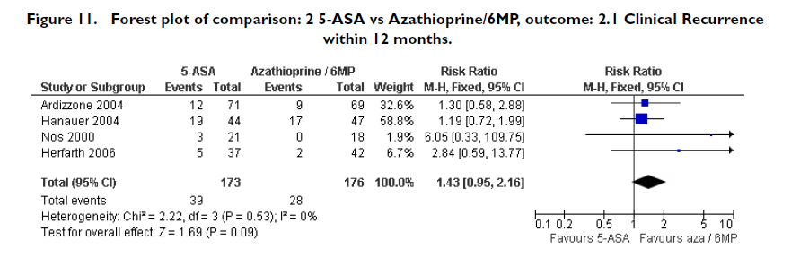
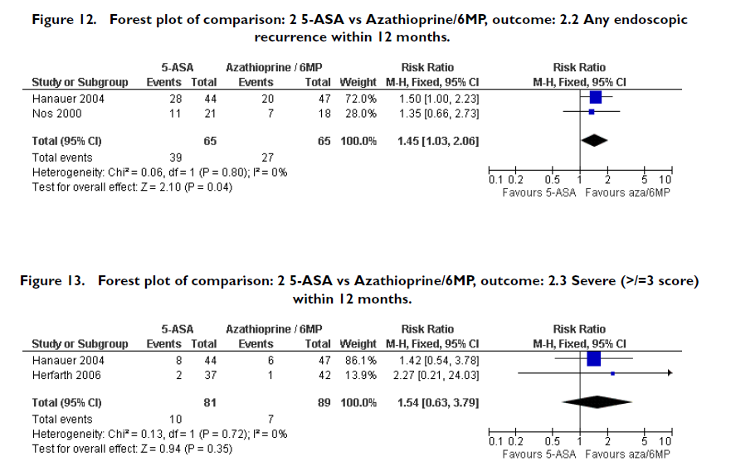
Tiopurines vs 5-ASA

Slide 33
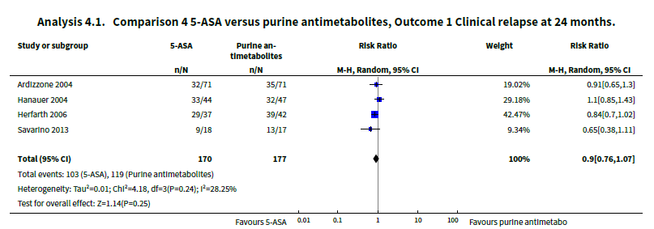
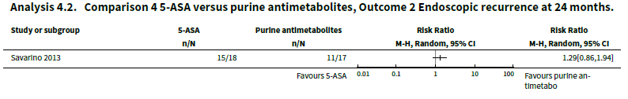
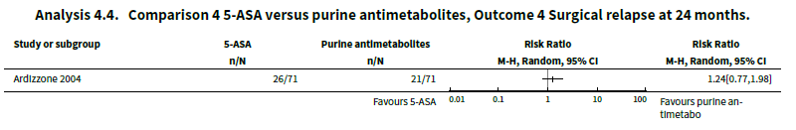
Tiopurines vs 5-ASA

Slide 34
Cochrane Database of Systematic Reviews
Ten RCTs with a total of 928 participants were included. Study participants were adults recruited from university clinics and gastroenterology hospitals who received interventions post‐surgery for a duration between 12 to 36 months. Most study participants were recruited less than three months after surgery in all except one study where participants were recruited between 6 to 24 months post‐surgery. One study was rated as low risk of bias, six studies were rated high risk of bias and three were rated unclear risk of bias.
There was moderate certainty evidence that purine analogues are more efficient for preventing clinical relapse than placebo. At 12 to 36 months, 51% (109/215) of AZA/6‐MP participants relapsed compared to 64% (124/193) of placebo participants (RR 0.79; 95% CI 0.67 to 0.92; 408 participants; 3 studies; I² = 0%; moderate certainty evidence). The certainty of the evidence regarding the efficacy of AZA or 6‐MP for maintaining postoperative clinical remission compared to 5‐ASA compounds was low. At 12 to 24 months , 64% (113/177) of purine analogue participants relapsed compared to 59% (101/170) of 5‐ASA participants (RR 1.05; 95% CI 0.89 to 1.24; 347 participants; 4 studies; I² = 8%; low certainty evidence). The certainty of evidence that purine analogues are inferior for preventing postsurgical clinical relapse compared to tumour necrosis factor alpha agents (anti‐TNF‐α) was very low. At 12 to 24 months, 43% (29/67) of AZA participants relapsed compared to 14% (10/72) of anti‐TNF‐α participants (RR 2.89; 95% CI 1.50 to 5.57; 139 participants; 3 studies; I² = 0%; very low certainty evidence).
The effect of purine analogues compounds on AEs compared to placebo or any active treatment was uncertain, as the quality of evidence ranged from very low to low. After 12 to 24 months, 14% (12/87) of purine analogue participants experienced an AE compared to 10% (8/81) of placebo participants (RR 1.36; 95% CI 0.57 to 3.27; 168 participants; 2 studies; I² = 0%; low certainty evidence). The effect of purine analogues on AEs compared to 5‐ASA agents was uncertain. After 12 to 24 months, 41% (73/176) of purine analogue participants had an AE compared to 47% (81/171) of 5‐ASA participants (RR 0.89; 95% CI 0.74 to 1.07; 346 participants; 4 studies; I² = 15%; low certainty evidence). The effect of purine analogues on AEs in comparison to anti TNF‐α agents was uncertain. At 12 to 24 months, 57% (32/56) of AZA participants had an AE compared to 51% (31/61) of anti‐TNF‐α participants (RR 1.13; 95% CI 0.83 to 1.53; 117 participants; 2 studies; I² = 0%; low certainty evidence). Purine analogue participants were more like than 5‐ASA participants to have a SAE (RR 3.39, 95% CI 1.26 to 9.13, 311 participants; 3 studies; I² = 9%; very low certainty evidence), or to withdraw due to an AE (RR 2.21, 95% CI 1.28 to 3.81; 425 participants; 5 studies; I² = 0%; low certainty evidence). Commonly reported AEs across all studies included leucopenia, arthralgia, abdominal pain or severe epigastric intolerance, elevated liver enzymes, nausea and vomiting, pancreatitis, anaemia, nasopharyngitis and flatulence.
Authors' conclusions
Moderate certainty evidence suggests that AZA and 6‐MP may be superior to placebo for maintenance of surgically‐induced remission in participants with CD. There was no clear difference in the number of clinical relapses when purine analogues were compared with 5‐ASA agents, however this is based on low certainty evidence. There was very low certainty evidence that AZA and 6‐MP are more likely to result in more serious adverse events (SAEs) and withdrawals due to an AE (low certainty) when compared to 5‐ASA agents. Very low certainty evidence suggests that purine analogues may be inferior to anti‐TNF‐α agents, however, no firm conclusions can be drawn. Further research investigating the efficacy and safety of AZA and 6‐MP in comparison to other active medications in surgically‐induced remission of CD is warranted.

Slide 35
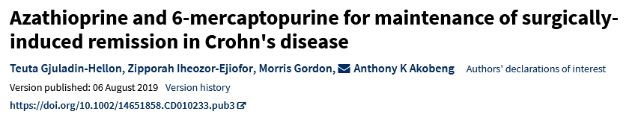
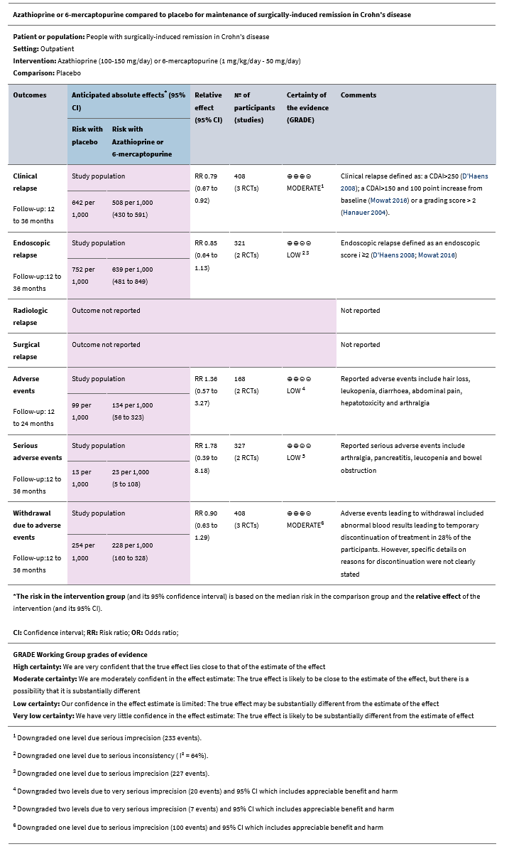
Cochrane Database of Systematic Reviews 06 August 2019

Slide 36
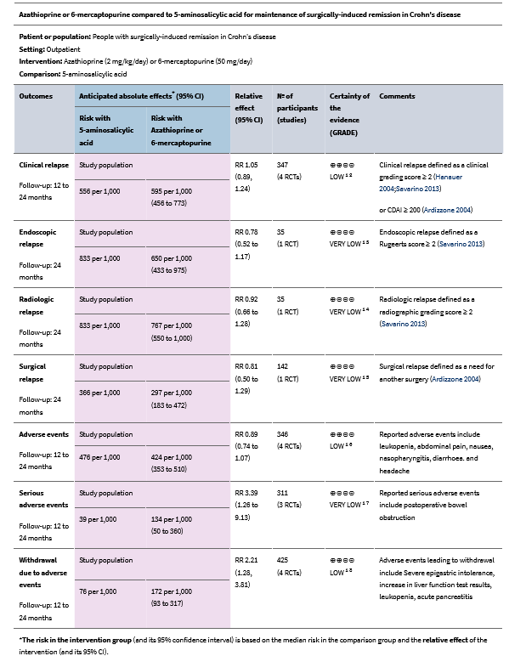

Slide 37
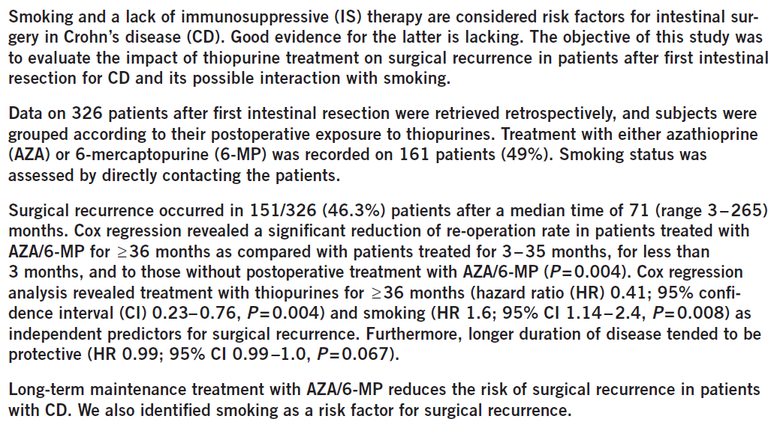

Slide 38
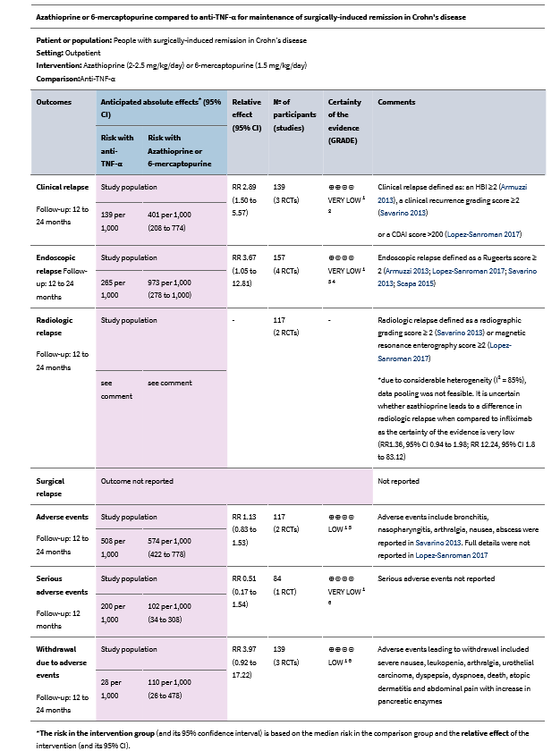

Slide 39
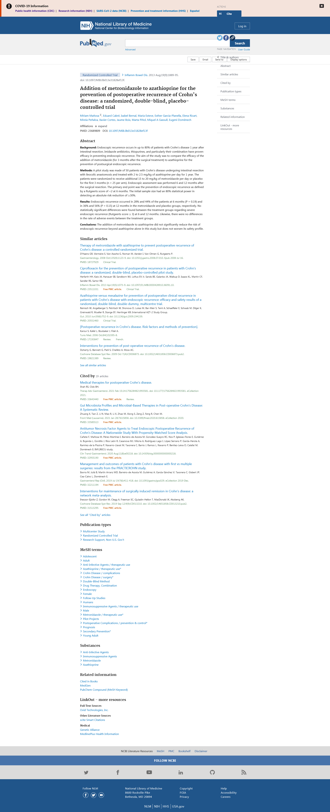
Tiopurines + Metronidazole
81 high risk
pts randomized
40 pts metronidazolo 250mg tid + AZA 100-150mg/d
SEVERITY OF
ENDOSCOPIC RECURRENCE
41 pts metronidazolo 250mg tid + placebo
ENDOSCOPIC RECURRENCE
24% drop-outs at 12 months
10 pts clinical recurrence

Slide 40
(CDAI) is widely used as the ‘gold standard’ for defining disease activity in clinical trials. Despite being used as the primary endpoint in studies assessing post-operative recurrence, its validity in this setting has only recently been assessed: Walters et al. followed 93 patients after ileal or ileocolonic resection with serological, endoscopic and symtomatic assessors of recurrence at 12 months as part of the CAST (Canadian American Surgical Crohn’s disease trial).14 A CDAI > 148 predicted recurrence (endoscopic and symptomatic) with 70% sensitivity and 81% specificity with good correlation demonstrated with the IBD Questionnaire (r = 0.82). However, as the authors point out, sole reliance on CDAI as an outcome measure in defining recurrence in their data would result in 50% of the identified cases in reality being unaffected. Combining CDAI with endoscopic assessment improved specificity to 96% underlining the merits of a combined approach in post-operative disease evaluation.
Clinical recurrence occurs in up to one-third of patients within 1 year and increases steadily so that, by 20 years after resection, up to 80% of patients have symptomatic recurrence.6, 7, 1
They conclude that active smoking remains the only strong predictor of recurrence with a twofold increased risk conferred to these patients. There is conflicting evidence for perianal disease, disease behaviour, previous resection and previous small bowel resection >50 cm, although overall these are seen to confer a modest increased risk. I

Slide 41
BUDESONIDE
Patients
Hellers 1999
129
ENDOSCOPIC RECURRENCE
12 MONTHS
Ewe 1999
83
Pooled RD (95% CI) - 3.5%
(95% CI: -16.9% to 9.8%)
p = 0.30
Pooled
212
Patients
CLINICAL RECURRENCE
12 MONTHS
Hellers 1999
129
Ewe 1999
83
Pooled RD (95% CI) - 3.0%
(95% CI: -15.0% to 8.8%)
p = 0.33
Pooled
212
Budesonide
Placebo
C.Papi et al. Alim Pharmacol Ther 2000

Slide 42
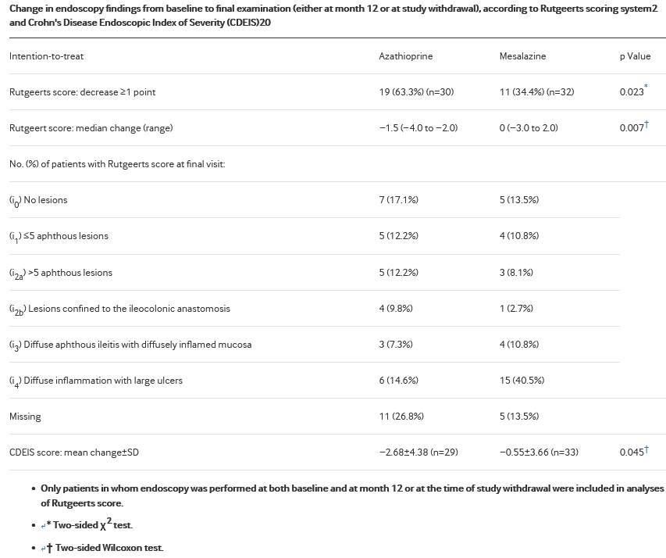
Significantly fewer azathioprine-treated patients had a severe endoscopic score (Rutgeerts i₃–i₄) at their final visit compared with patients in the mesalazine group (9/30 (30.0%) vs 19/32 (59.4%), difference −29.4%, 95% CI (−53.0% to −5.7%), p=0.020, two-sided). Similar findings were observed in the PP endoscopy group (data not shown).

Slide 43
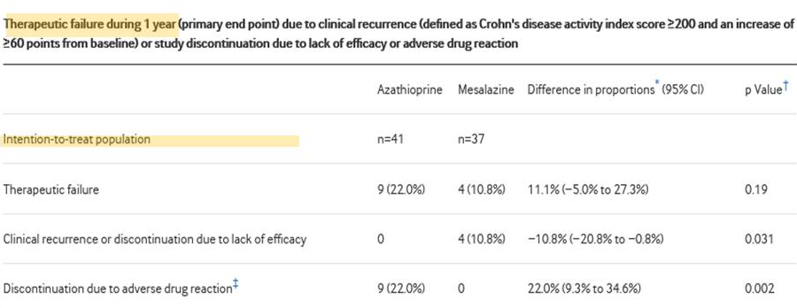
Notes:
Therapeutic failure (due to clinical recurrence or discontinuation due to lack of efficacy or adverse effects) in favour of mesalazine
Clinical recurrence was less frequent in the azathioprine
Discontinuation due to adverse drug reactions was more frequent in the azathioprine-treated patients

Slide 44

PROBIOTICS
ENDOSCOPIC RECURRENCE
CLINICAL RECURRENCE
Cochrane odds ratio plot (random effects)
Cochrane odds ratio plot (random effects)
Van Gossum A, 2007 - LLA
Marteau P, 2006 - LLA
Prantera 2002 - LGG
0,1
0,2
0,5
1
2
5
10
0,1
0,2
0,5
1
2
5
10
100
DL pooled odds ratio = 1,303729 (95% CI = 0,522961 to 3,250163)
DL pooled odds ratio = 0,963519 (95% CI = 0,431903 to 2,149485)
PROBIOTIC CONTROL
PROBIOTIC CONTROL
Rahimi R et al. Dig Dis Sci 2009

Slide 45


Tiopurines

Slide 46

5-ASA vs Tiopurines

Slide 47
Tiopurines
Cumulative probability of surgical recurrence
1.00
0.75
0.50
0.25
0.00
0
20
40
60
80
100
120
Months
Number at risk
iss_1 anno = 0
85
83
77
73
64
54
44
iss_1 anno = 1
78
70
66
50
42
33
25
iss_ 1 anno = 0
iss_ 1 anno = 1
1.00
0.75
0.50
0.25
0.00
0
20
40
60
80
100
120
Months
Number at risk
iss_tre anni = 0
40
40
40
40
38
34
25
iss_tre anni = 1
123
113
103
83
68
53
44
iss_tre anni = 0
iss_tre anni = 1

Slide 48


Tiopurines vs Placebo

Slide 50


Slide 51


Mesalamine
NNT 16-19
severe endoscopic recurrence NNT 8

Slide 52
Methodological Consideration: sample size
Assuming
23% clinical recurrence in placebo
10% reduction risk with treatment
462 pts enrolled
23% clinical recurrence in placebo
20% reduction risk with treatment
86 pts enrolled
50% endoscopic recurrence in placebo
10 % reduction risk with treatment
774 pts enrolled
50% endoscopic recurrence in placebo
20% reduction risk with treatment
186 pts enrolled
ADEGUATELY POWERED
TRIAL
TO SHOW
STATISTICAL SIGNIFICANCE
Alpha 5% (0.05): type I error
The probability to find a difference when a difference does not exist. A 5% chance that a significant difference is actually due to chance and is not a true difference.
Beta: beta 20% (0.2) type II error
The probability to not detect a difference when one actually exists. A 20% chance that a significant difference is missed.
Power of the study= 1 - β.

